Slide 1
Ano-rectal Abscesses& Fistulas
By:
Ibrahim Falih Noori

Slide 2
Pathophysiology
Perirectal abscesses and fistulas represent anorectal disorders arising predominantly (~90% of cases) from the obstruction of anal crypts glands.
Infection of the static glandular secretions results in suppuration and abscess formation within the anal gland.
Typically, the abscess forms initially in the intersphincteric space and then spreads along adjacent potential spaces..

Slide 3
Incidence

Slide 4
Etiology
Both aerobic and anaerobic bacteria have been found to be responsible for abscess formation.
The aerobes most commonly implicated are Staphylococcus aureus, Streptococcus, and Escherichia coli
The anaerobes most commonly implicated are Bacteroides fragilis, Peptostreptococcus,
Approximately 10% of anorectal abscesses may be caused by reasons other than anal gland infection, including Crohn disease, trauma, immunodeficiency resulting from HIV infection or malignancy (both hematologic and anorectal cancer), tuberculosis, hidradenitis suppurativa, sexually transmitted diseases, radiation therapy, foreign bodies, perforated diverticular disease, inflammatory bowel disease, or appendicitis (a rare cause of supralevator abscesses)

Slide 5
Types of ano-rectal abscess
The classic locations of anorectal abscesses, listed in order of decreasing frequency, are as follows:
Perianal (60%)
Ischiorectal (30%)
Intersphincteric (5%)
Supralevator (4%)
Submucosal (1%)

Slide 6
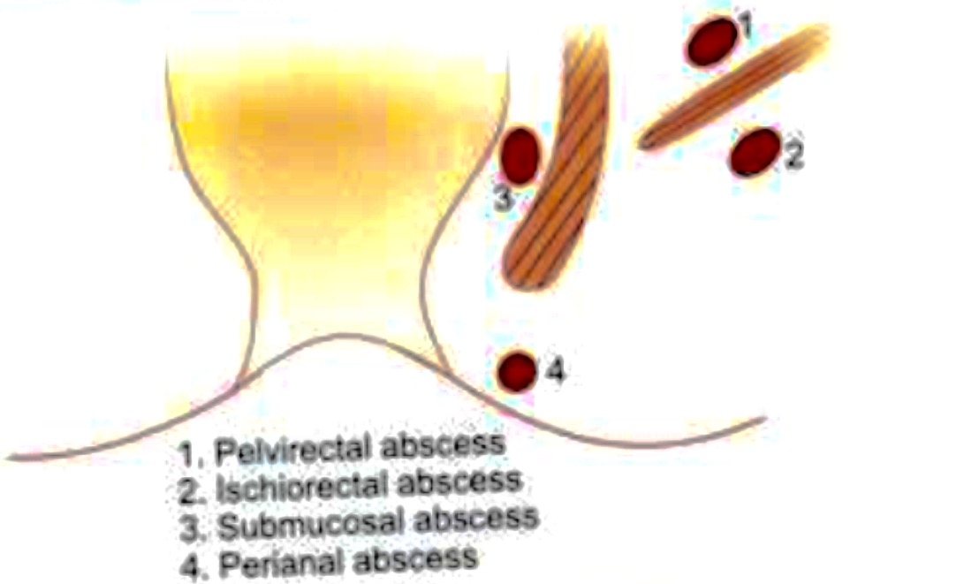

Slide 7
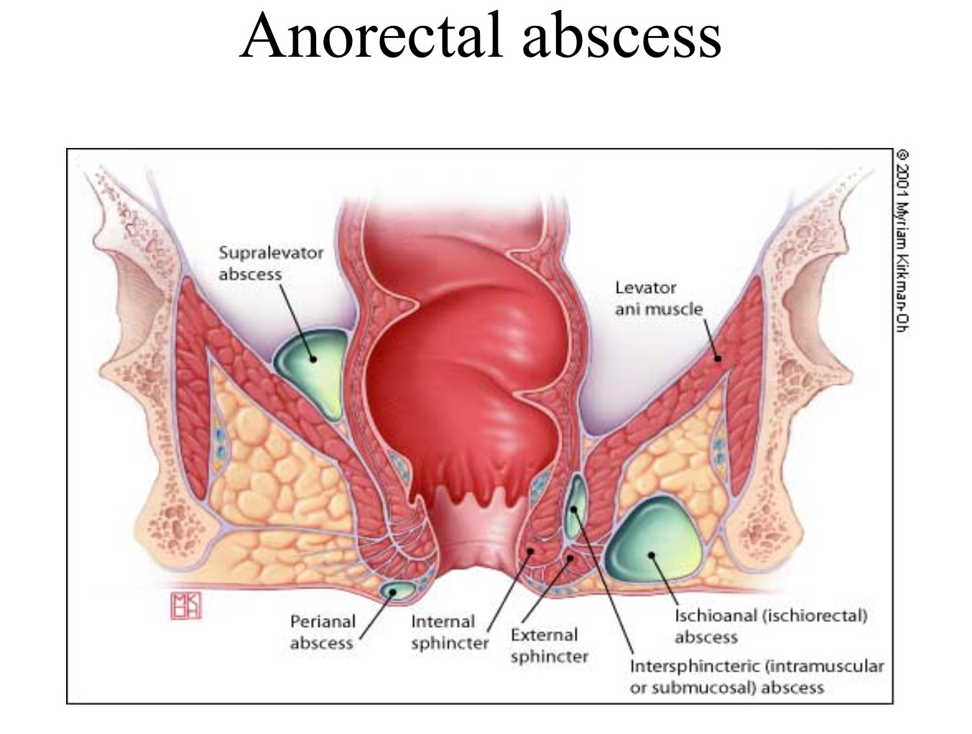

Slide 8
Clinical presentation
History:
The clinical presentation correlates with the anatomic location of the abscess
Almost all perirectal abscesses are associated with perirectal pain .
Patients with a perianal abscess typically complain of dull perianal discomfort and pruritus.
Those with an ischiorectal abscess often present with systemic fevers, chills, and severe perirectal pain and fullness
As many as 50% of patients with perirectal abscesses may present with swelling around the rectum, and as many as one quarter may present with rectal or perirectal drainage that may be bloody, purulent, or mucoid.

Slide 9
Clinical presentation
Physical examination
Patients with anorectal abscesses usually have normal vital signs on initial evaluation, with only 21% reporting fevers or chills.
Physical examination demonstrates a small, erythematous, well-defined, fluctuant, subcutaneous mass near the anal orifice.
On digital rectal examination (DRE), a fluctuant, indurated mass may be encountered.
Patients with an intersphincteric abscess present with rectal pain and exhibit localized tenderness on DRE. Physical examination may fail to identify an intersphincteric abscess.
Digital examination with anesthesia can be helpful in certain cases, because patient discomfort can significantly limit physical assessment.

Slide 10
Perianal abscess (60%)
Results due to suppuration of anal glands or suppuration of thrombosed external pile or any infected perianal condition.
It lies in the region of subcutaneous portion of external sphinecter.
Clinical features includes severe pain in Perianal region with difficulty to sit.
Tender, smooth,soft swelling in the region.
Treatment include:
Sitz bath, antibiotics,analgesic s,local application of anesthetic agents and laxatives.
Drainage under G/A.

Slide 11
Ischiorectal abscess (30%)
Surgical anatomy of ischiorectal fossa
Ischiorectal fossa ( pyramidal shape 5 cm depth and 2 cm width) lies between anal skin and levator ani.
Right and left fossa communities with each other.
Laterally, it is related to fascia covering obturator internus, medially to levator ani and external sphincter. Posteriorly sacrotuberous ligament and gluteus maximus.
Anteriorly urogenital diaphragm. Below, the floor by skin.
Above it is related to lunate fascia and pudendal neurovascular bundle in pudendal canal ( Alcock’s canal)

Slide 12
Ischiorectal fossa

Slide 13
Ischiorectal abscess
It is due to extension of low intermuscular anal abscess laterally through rhe external anal sphinecter.
It can be blood or lymphatic born.
Fat in the fossa is more prone for infection because it is least vascularized.
Fossa communities with that of opposite side through postsphincteric space and so horse- shoe like abscess can occur.
Presents as tender, indurated, brawny swelling in the skin over the ischiorectal fossa with high fever.
Swelling is not well localized and fluctuation is abscent.
Treatment is drainage under G/A in lithotomy position through a cruciate incision with deroofing . Pus is sent for C/S.

Slide 14
Cruciate incision and deroofing

Slide 15
Submucous abscess.(5%)
It occurs above the dentate line, which can be drained with sinus forceps, through a proctoscope.
Presents as aching pain in the anorectum with significant perineal discomfort.
On DRE: tender , soft, smooth swelling in the lower rectum and anal canal.
It may be missed clinically as there is no obvious swelling externally.
Treatment is proper antibiotics, incision and drainage under G/A.

Slide 16
Pelvirectal abscess. (5%)
It is situated between the upper surface of levator ani and pelvic peritoneum
It is almost like pelvic abscess occurs secondary to appendicitis , salpangitis, diverticulitis and Crohn’s disease.
U/S abdomen is done to rule out the pelvic pathology.
Treatment accordingly after thorough investigations for diabetes, Crohn’s and other condition

Slide 17
Complications of anorectal abscess
Recurrent abscess formation
Fistula formation.

Slide 18
Perianal abscess
Ischiorectal abscess

Slide 19
Fistula in Ano

Slide 20
Fistula in ano
It is an abnormal track lined by granulation tissue which connects perianal skin externally to anal canal, anorectum, or rectum deeply.
It is usually occurs in a pre-existing anorectal abscess which bursts spontaneously.
Other causes include: tuberculosis, carcinoma, Crohn’s disease, ulcerative colitis, lymphogranuloma venerum, hydraadentis suppuritiva and traumatic

Slide 21
Classifications

Slide 23
Parks classification
is the one most commonly used for fistula-in-ano.
This system defines four types of fistula-in-ano that result from cryptoglandular infections, as follows:
Intersphincteric (70%)
Transsphincteric (25%)
Suprasphincteric (4%)
Extrasphincteric (1%)

Slide 24
Park’s classification

Slide 25
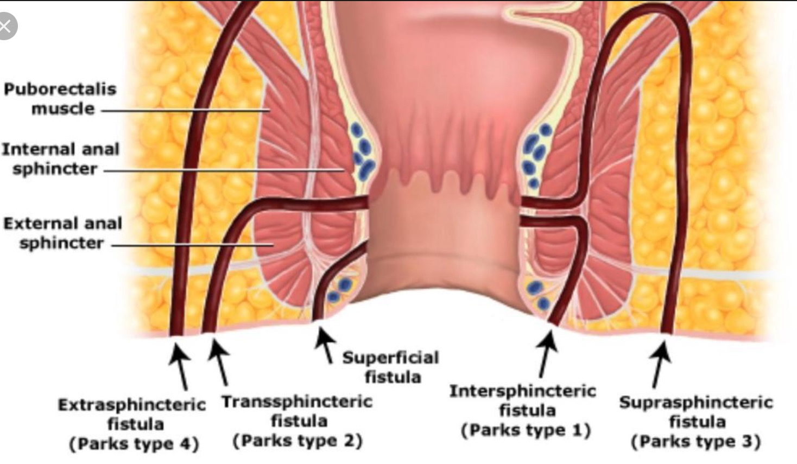

Slide 27
Fistula in ano
Horseshoe posterior anal fistulas

Slide 28
Goodsall’s rule

Slide 29
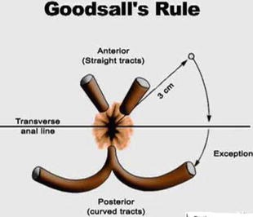

Slide 30
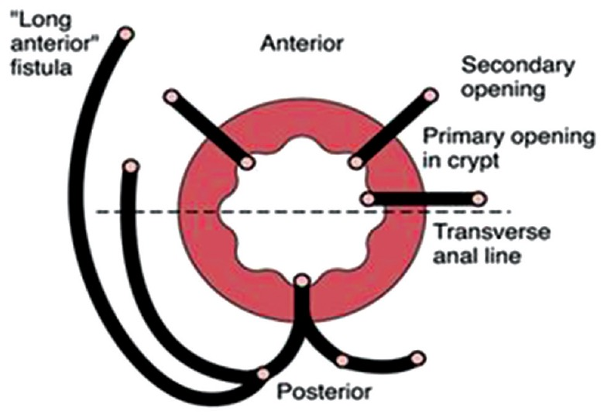

Slide 31
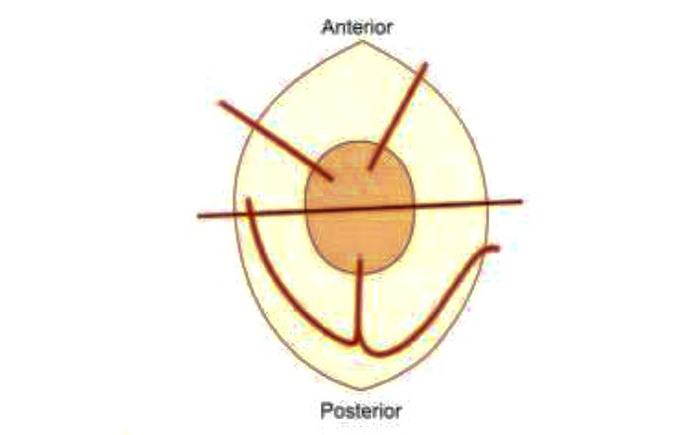
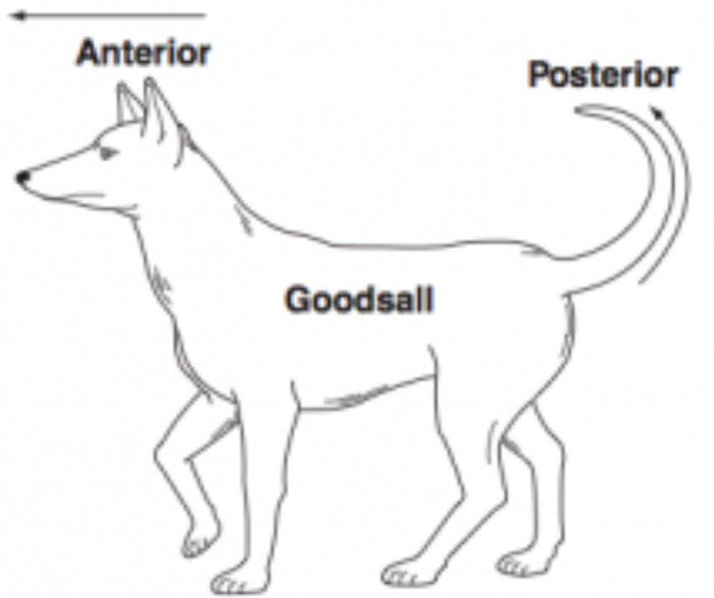
Goodsall rule: Anterior fistulas are having straight track. Posterior fistulas are having curved track with internal opening in the posterior midline

Slide 32
Clinical features
History
Perianal discharge
Pain
Swelling
Bleeding
Diarrhea
Skin excoriation
External opening

Slide 33
Clinical features
Physical findings are the mainstay of diagnosis.
An external opening that appears as an open sinus or elevation of granulation tissue.
Spontaneous discharge of pus or blood via the external opening may be apparent or expressible on digital rectal examination.
Digital rectal examination (DRE) may reveal a fibrous tract or cord beneath the skin.
Lateral or posterior induration suggests deep postanal or ischiorectal extension.

Slide 34
Investigations

Slide 35
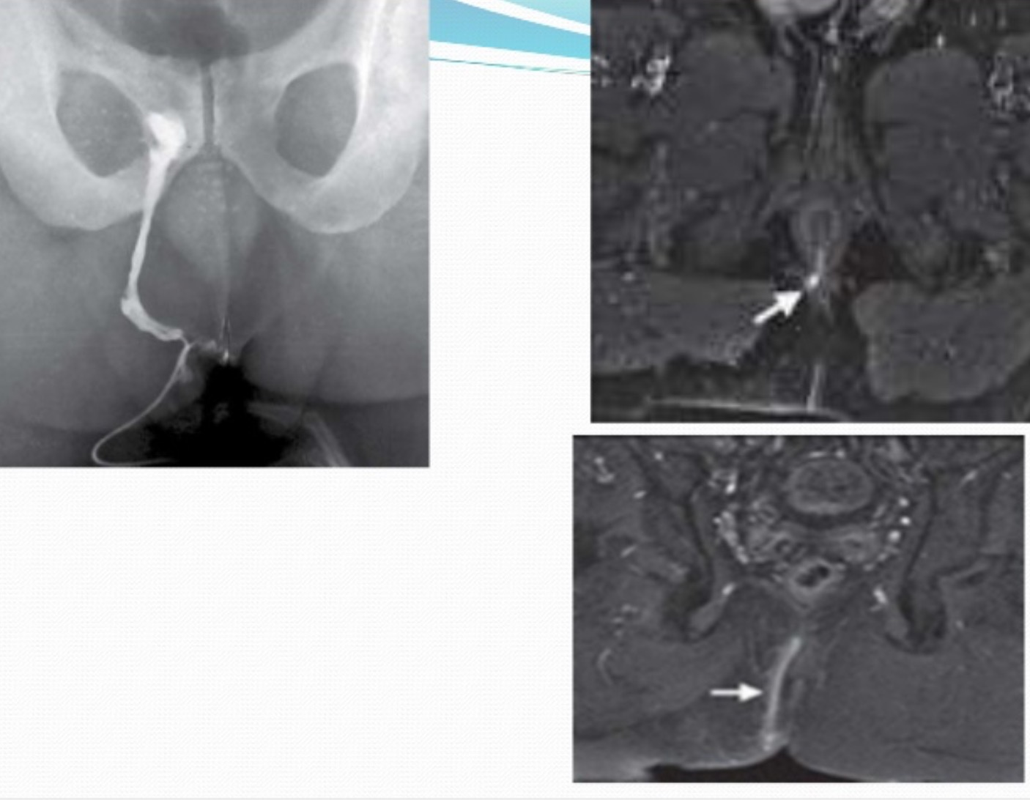

Slide 36
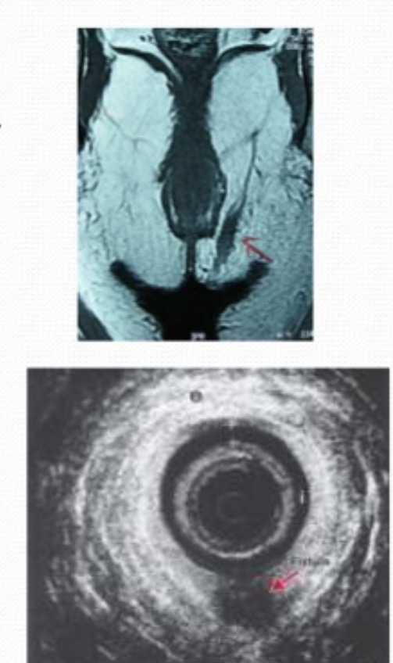
MRI & Endorectal ultrasound of anal fistula

Slide 37
Treatment

Slide 38
Treatment options
Fistulotomy
Fistuloectomy.
Seton technique. ( loose seton and cutting seton)
Anal fistula plug.
Fibrin glue.
Ano-rectal advancement flap.
Ligation of intersphincteric fistula tract (LIFT procedure)
Video assisted anal fistula treatment.
Fistula laser closure ( FiLaC)
Diverting stoma.

Slide 42
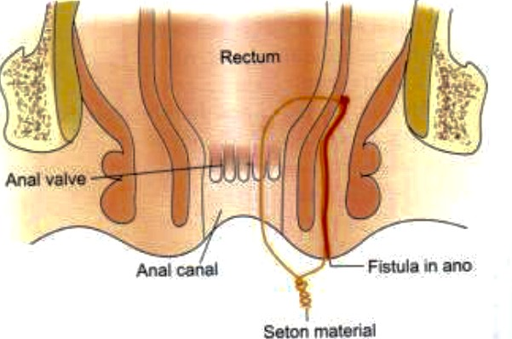

Slide 43
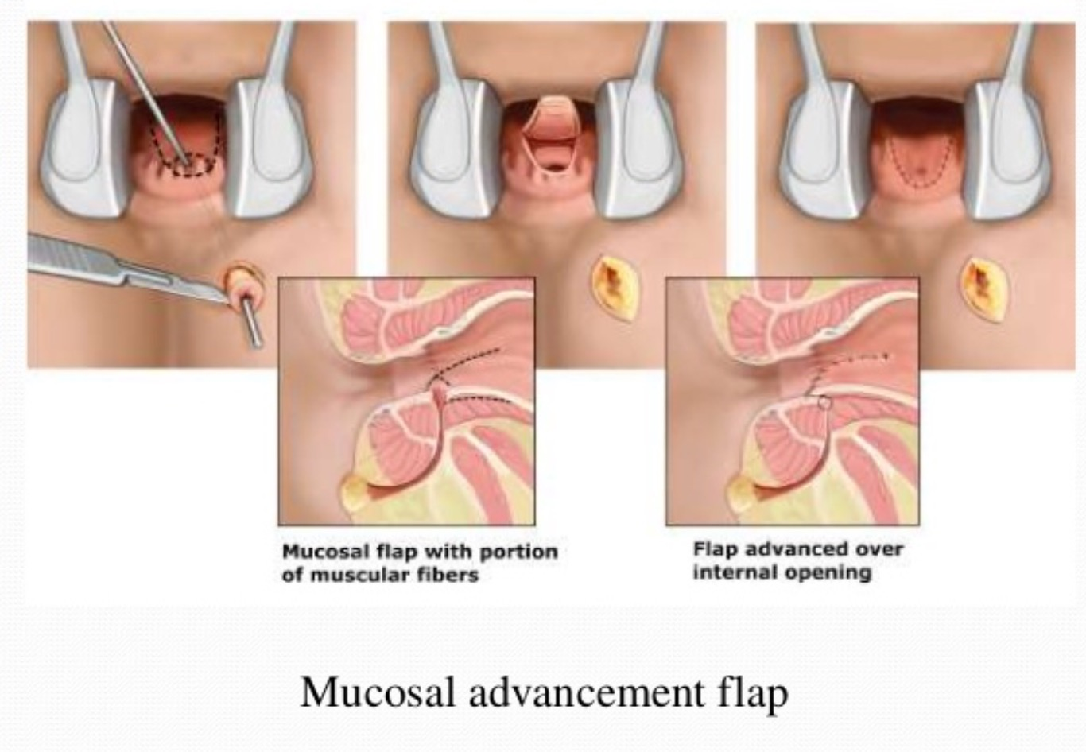

Slide 44
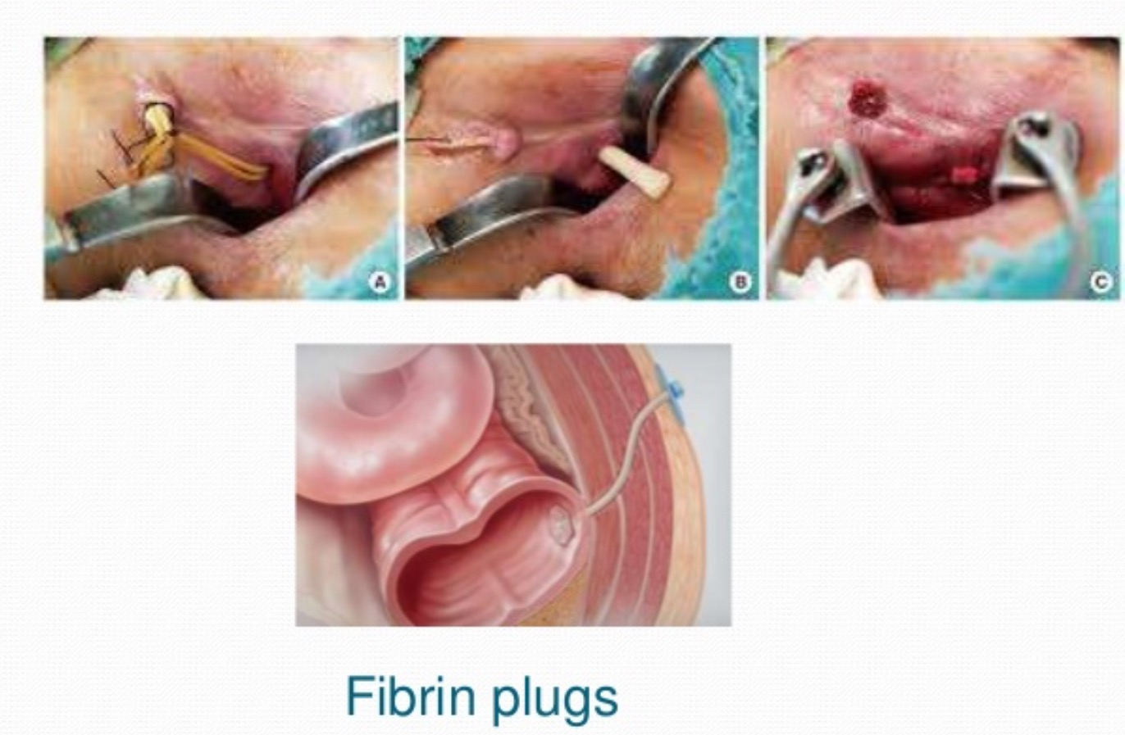
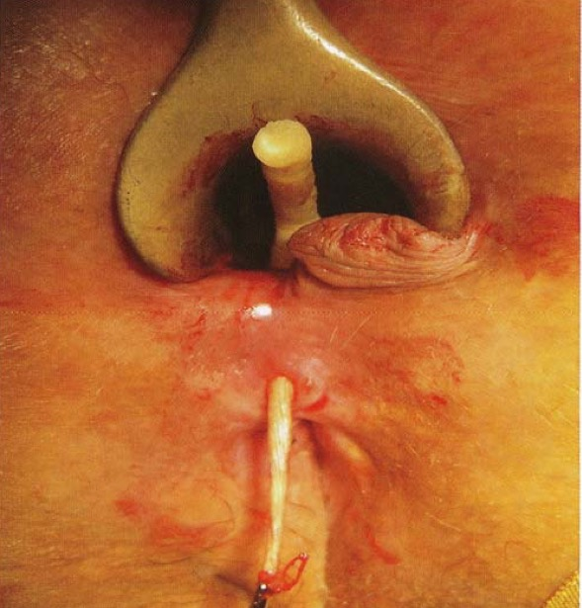

Slide 45
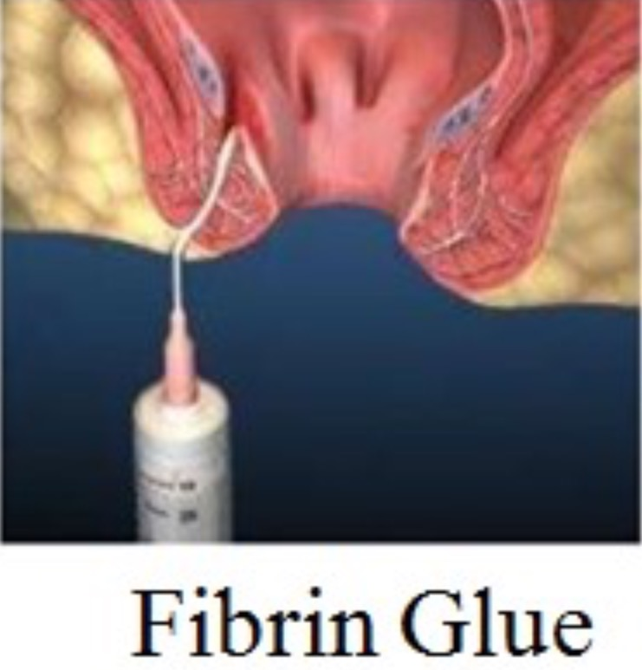

Slide 46
High level anal fistula

Slide 47
Treatment of high level anal fistula

